Slide 1
NORTHWIND SALES DATA ANALYSIS
-BY GAGANA.R

Slide 2
AGENDA
2
Data analysis
Northwind Sales Data Analysis
Analysis done using SQL
Key Takeaway

Slide 3

DATA ANALYSIS
3
Data Analysis is the process of analyzing raw data to find trends, insights and patterns that help in decision-making and solving real world business problems.
KEY ASPECTS:
COLLECTION: Gathering data from multiple sources.
PROCESSING: Cleaning and transforming data.
ANALYSIS: Applying statistical and machine learning techniques.
VISUALIZATION: Presenting data in an understandable format.

Slide 4
NORTHWIND SALES DATA ANALYSIS
In order to make data analysis, we will be using the Northwind File (SQL Server Backup File).
The Northwind database simulates a small business with tables for customers, orders, products, employees and more.
We will be using this SQL Backup file which is Northwind in our data analysis using SQL.
LET’S SEE HOW WE CONDUCT OUR DATA ANALYSIS USING SQL IN THE CORRESPONDING QUESTIONS WITH IT’S CODE AND OUTPUT TO UNDERSTAND IT BETTER.

Slide 5
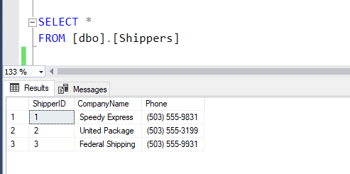
1.Which shippers do we have?
WE USE SELECT STATEMENT TO SHOW THE LIST OF SHIPPERS.

Slide 6
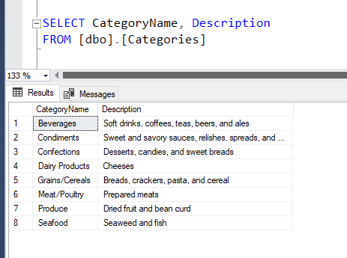
2.Certain fields from Categories
WE USE SELECT STATEMENT AND COMMA (,) OPERATOR TO SHOW ONLY SPECIFIC COLUMNS FROM THE CATEGORIES TABLE.

Slide 7
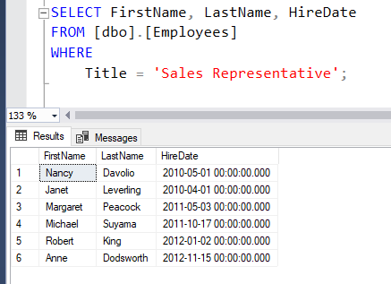
3.Sales Representatives
WE USE WHERE CLAUSE TO FILTER THE VALUES.

Slide 8
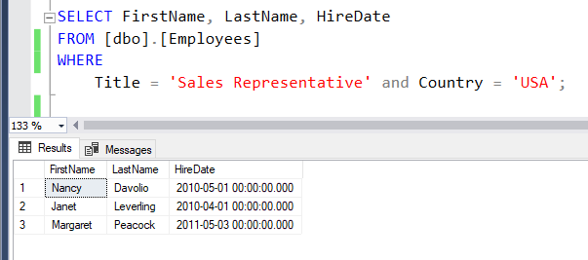
4.Sales Representatives in the United States
WE USE WHERE CLAUSE TO FILTER AND USE AND OPERATOR TO COMBINE MULTIPLE CONDITIONS.

Slide 9
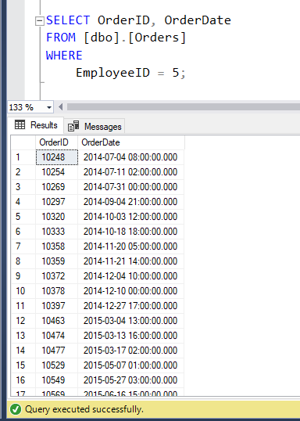
5.Orders placed by specific EmployeeID
WE USE WHERE CLAUSE TO FILTER RECORDS.

Slide 10
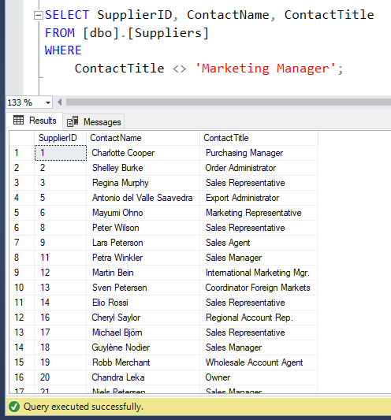
6.Suppliers and ContactTitles
WE USE <> OPERATOR TO FILTER OUT ROWS WHERE TWO ARE NOT EQUAL.

Slide 11
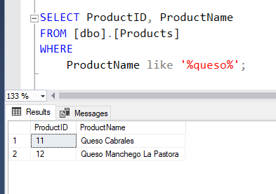
7.Products with “queso” in ProductName
WE USE LIKE OPERATOR WITH WILDCARDS TO SEARCH FOR A SPECIFIED PATTERN IN A COLUMN.

Slide 12

8.Orders shipping to France or Belgium
WE USE OR OPERATOR IN WHERE CLAUSE TO COMBINE MULTIPLE CONDITIONS.

Slide 13
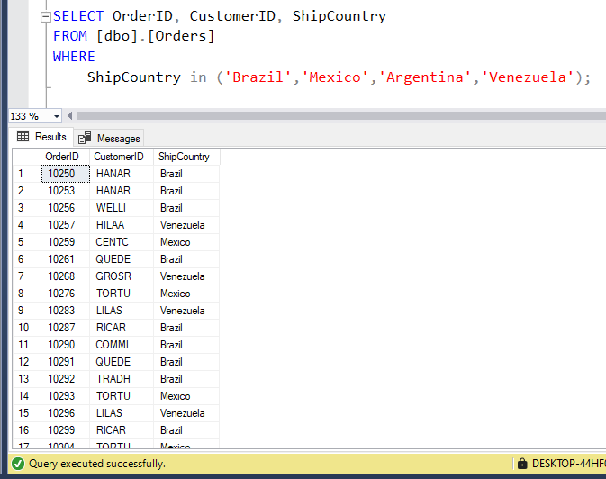
9.Orders shipping to any country in Latin America
WE USE IN OPERATOR TO MATCH A VALUE AGAINST A LIST OF VALUES.

Slide 14
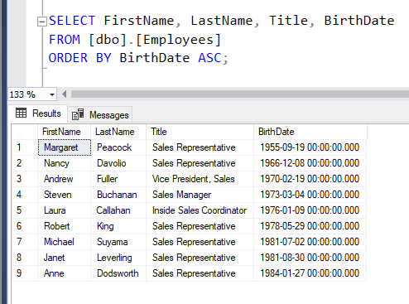
10.Employees, in order of age
WE USE ORDER BY CLAUSE TO SORT THE RESULT SET EITHER IN ASCENDING(ASC) OR DESCENDING(DESC) ORDER.

Slide 15
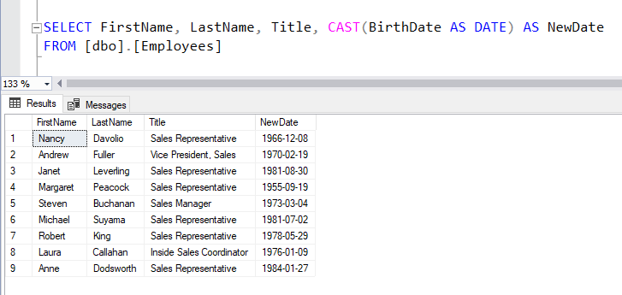
11.Showing only the Date with a DateTime field
WE USE CAST OPERATOR TO CONVERT ONE DATATYPE TO ANOTHER.

Slide 16
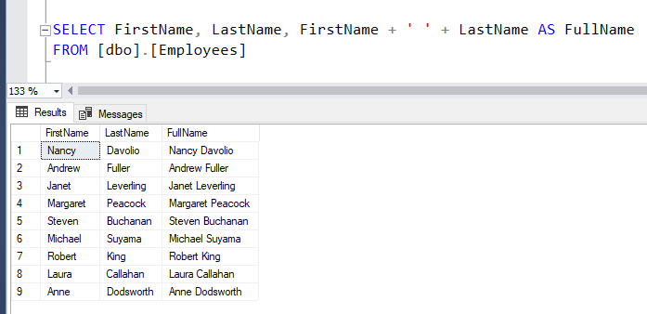
12.Employees full name
WE USE + ‘ ‘ + TO PERFORM CONCATENATION OPERATION.

Slide 17
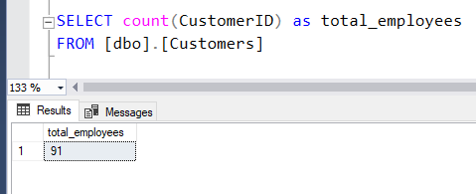
14.How many customers?
WE USE COUNT OPERATOR TO COUNT THE NUMBER OF ROWS.

Slide 18

KEY TAKEAWAYS
We used SQL for analyzing the Northwind database .
By using various SQL FUNCTIONS we were able to analyze the data better.

Slide 19
Thank You

